Slide 1
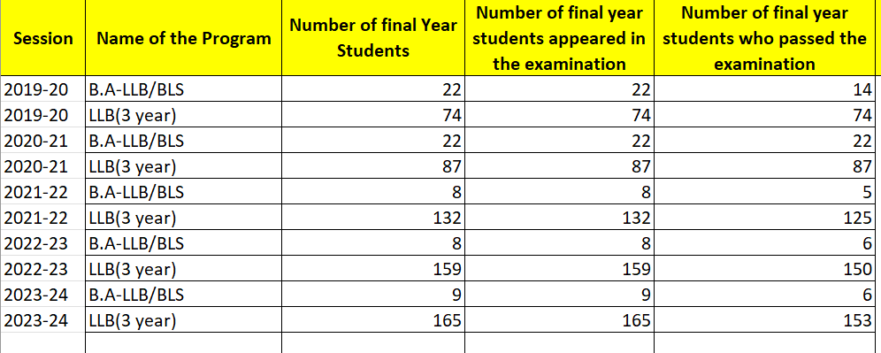
1. Result analysis

Slide 2
2. ADMISSION NUMBERS (COURSE & YEAR WISE)
KINDLY CHECK THE LINK FOR FURTHER DETAILS –
https://stwilfredslaw.in/2-1-2-percentage-of-seats-filled-against-reserved-categories-sc-st-obc-etc-as-per-applicable-reservation-policy-for-the-first-year-admission-during-the-last-five-years/

Slide 3
3. TOPPERS DETAILS
2021-2022
LL.B-Ragunath Vithoba Tandel | B.L.S LL.B- Haresh Bhopi & Tajeshree Mhatre
2022-2023
LL.B- Sumedha Bhawar | B.A LL.B –Adharsh Divakar Pandey - Sujata Devidas Padvi
2023-2024
LL.B- Charushila Shekar Khairnar | B.A LL.B –Rani Vasant Pawar - Dyaneshwari Bajirao Fuge

Slide 4
4. PLACEMENT STATS & RECRUITER DETAILS
https://stwilfredslaw.in/5-2-1-percentage-of-placement-of-outgoing-students-during-the-last-five-years/

Slide 5
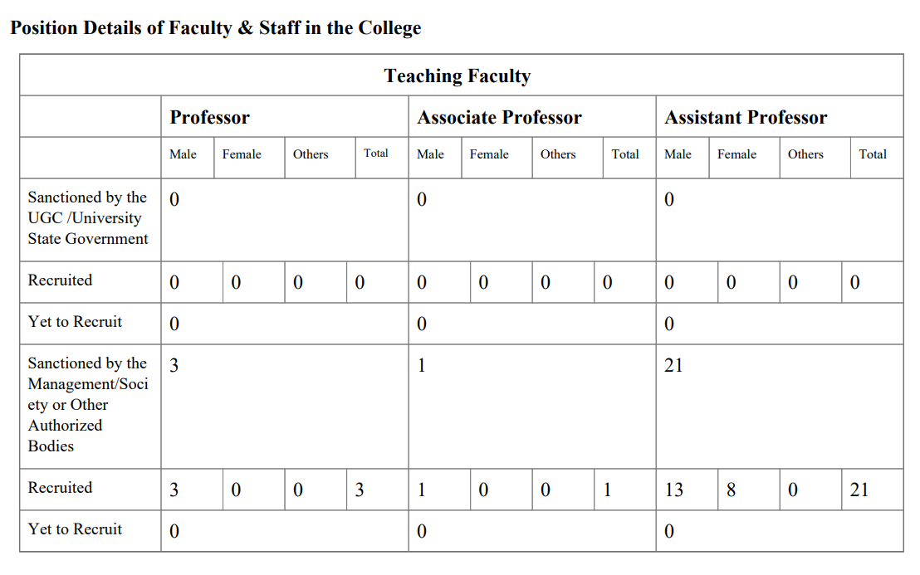
5. COMPLETE FACULTY LIST WITH QUALIFICATION

Slide 6
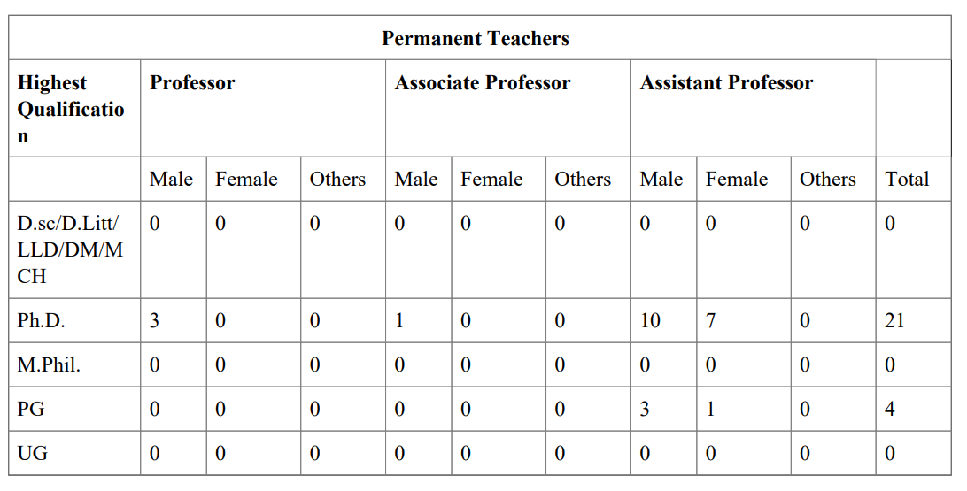
QUALIFICATION

Slide 7
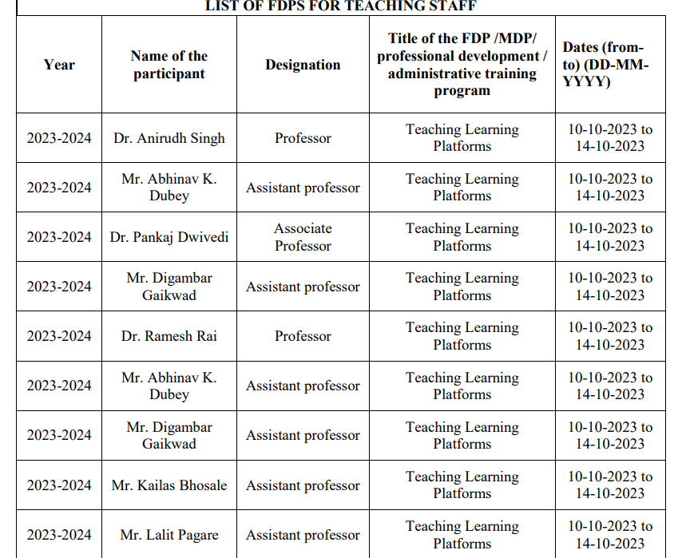
6. FDPs CONDUCTED/ ATTENDED BY FACULTY

Slide 8
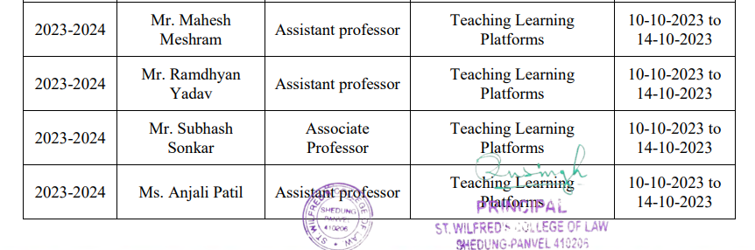
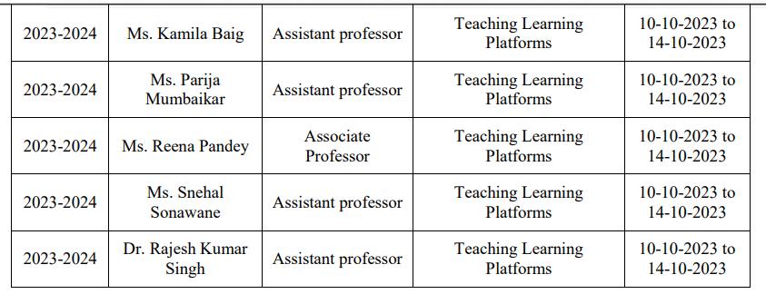

Slide 9
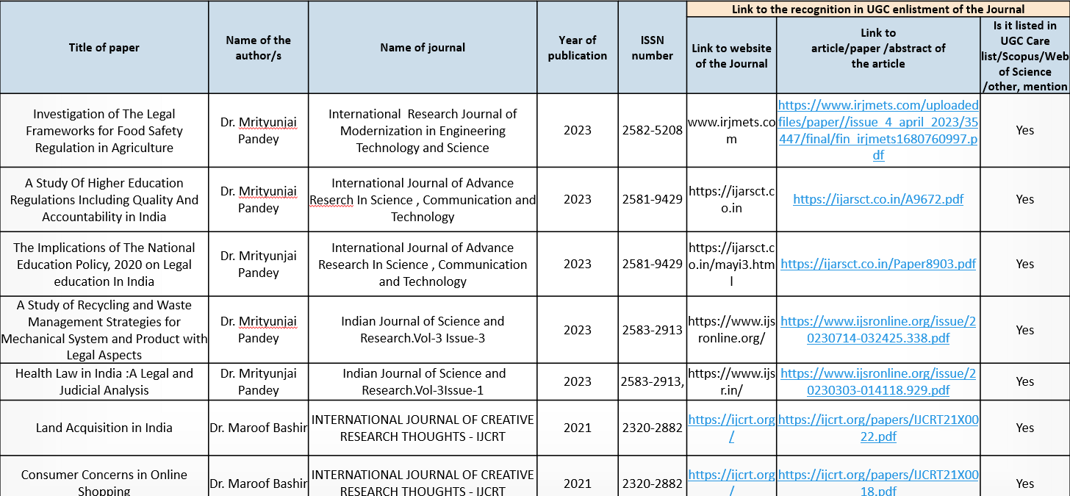
7. Faculty achievements

Slide 10
8.EVENTS ORGANISED BY DEPARTMENT
The institution conducts /organizes following activities
1. Sports competitions/events
2.Cultural competitions/events
3. Technical fest/academic fests
4. Any other events through active clubs and forums
KINDLY CHECK THE BELOW LINK FOR FURTHER INFORMATION-
https://stwilfredslaw.in/5-3-3the-institution-conducts-organizes-following-activities/

Slide 11
9. MAXIMUM PHOTOGRAPHS OF ALL EVENTS
KINDLY CHECK THE BELOW LINK -
Https://stwilfredslaw.in/wp-content/uploads/2024/12/3.3.2-_Activity_Report.pdf

Slide 12
10. STUDENTS ATTENDENCE ANALYSIS
Pending

Slide 13
11. PLANNING FOR UPCOMING ACADEMIC SESSION
KINDLY CHECKK THE BELOW LINK FOR INFORMATION
https://stwilfredslaw.in/1-1-1-the-institution-ensures-effective-curriculum-delivery-through-a-well-planned-and-documented-process-2/

Slide 14
12. ADMISSION CRITERIA AND PROCESS
Kindly check the Pdf sent separately .

Slide 15
13. SOFT COPY OF PROSPECTUS
Kindly check the Pdf sent separately

Slide 16
14. STUDENT PORTFOLIO
SR.NO | YEAR | NAME | POSITION
1 | 2023-2024 | Anil Upadhay | Law firm
2 | 2022-2023 | Preeti Salunkhe | Law firm
3 | 2022-2023 | Tejas Dattatreya Patil | Law firm
4 | 2022-2023 | Nishi Naval | Studying in USA
5 | 2022-2023 | Poorvi Khose | MNC as a Legal Advisor
6 | 2022-2023 | Pornima Makarand Behle | MNC as a Legal Advisor
7 | 2022-2023 | Nita Narkar | MNC as a Legal Advisor
8 | 2022-2023 | Akshay Manoj Ingale | Studying in UK
9 | 2022-2023 | Ravi Kiran Khaire | MNC as a Legal Advisor in Dubai

Slide 17
15. FACULTY PERFORMANCE REPORT
PENDING

Slide 18
16. CURICULLUM ACTIVITIES DELIVERY PLAN
https://stwilfredslaw.in/1-1-1-the-institution-ensures-effective-curriculum-delivery-through-a-well-planned-and-documented-process-2/

